Slide 1

ZOMATO RESTAURANT ANALYSIS
By
Naganathan Arjun MANICKA SRIDHAR

Slide 2
INTRODUCTION AND OBJECTIVES

Slide 3
Introduction and Objectives
Zomato is an online food delivery and restaurant aggregator platform that provides information, menus and user-reviews of restaurants as well as food delivery options from partner restaurants in more than 1,000 Indian cities with an estimated revenue of US $ 1.5 Billion (12,000 Crore INR).
Between 2011 and 2015, Zomato expanded internationally to 17+ countries such as UAE, Qatar, Sri Lanka, UK, New Zealand etc.
Problem Statement
The given dataset is huge and it is difficult to gain insights from it.
To analyse the factors and identify the strategies required for expanding the restaurants globally.
Solution
Address the problem statement by analyzing the data and create a dashboard with visuals comprising of various factors like customer ratings, average cost, online delivery, table booking etc.

Slide 4
DATA OVERVIEW

Slide 5
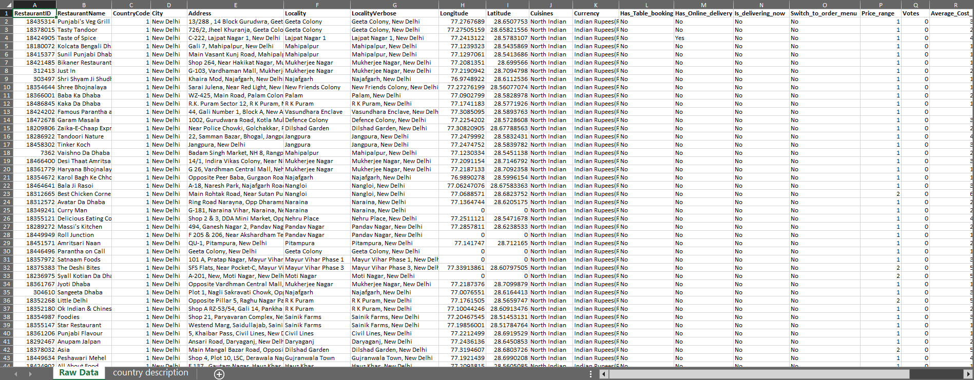
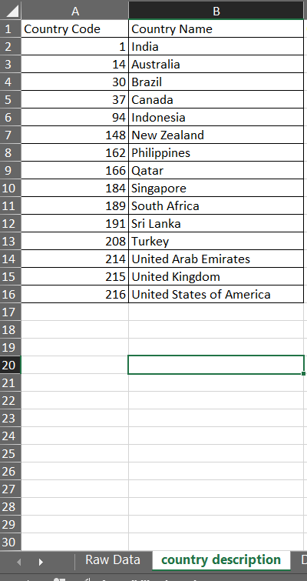
Data Overview
Table: Raw Data
Table: country description

Slide 6
Data Dictionary
The image above displays details about Zomato Sales Performance, including:
Restaurant ID: Unique identifier for each restaurant.
Restaurant Name: The name of the restaurant.
CountryCode: Country code of the location where the restaurant is situated.
City: The city where the restaurant is located.
Address: The specific address of the restaurant.
Locality: The locality or neighbourhood where the restaurant is situated.
Locality Verbose: Detailed information about the locality.
Longitude: The geographical longitude coordinate of the restaurant.
Latitude: The geographical latitude coordinate of the restaurant.
Cuisines: The type of cuisine offered by the restaurant.
Currency: The currency used for transactions in the restaurant.
Has_Table_booking: Indicates whether the restaurant has a table booking option (Yes/No).
Has_Online_delivery: Indicates whether the restaurant offers online delivery (Yes/No).
Is_delivering_now: Indicates whether the restaurant is currently delivering (Yes/No).
Switch_to_order_menu: Indicates whether users can switch to the order menu (Yes/No).
Price_range: A numeric value indicating the price range category of the restaurant.
Votes: The number of votes or ratings/(feedback) received by the restaurant.
Average_Cost_for_two: The average cost for two people dining at the restaurant.
Rating: The overall rating of the restaurant is based on user reviews.
Datekey_opening: The date when the restaurant was opened.

Slide 7
METHODOLOGY

Slide 8
Methodology
The steps involved in the data analysis is as follows:
1. Data Cleaning:
The dataset used for the analysis has to be preprocessed by performing data cleaning measures such as
Handling Missing Data
Remove Duplicates across data
a) Handling missing data:
Involves the identification of blank cells and replacing them with mean, median, mode in case of numerical values, most occurring value in case of text / string.
b) Remove Duplicates across data:
Crucial process for data preprocessing as non-removal of duplicate values will result in the analysis being less accurate.

Slide 9
Methodology
2. Data Enrichment:
Formulas - Calculate values from the data according to the requirement. For example, extract year from date to analyse the year-wise sales or customer count etc.
Aggregation / Conditional Aggregation functions – Functions like SUM, AVERAGE, MAX, MIN for calculating the values. For example, the total sales of restaurants in a city across a month or year etc.
LOOKUP functions – To looking through a single column or row to find a particular value from the same place in a second column or row.
3. Descriptive Analysis & Trend Analysis:
Pivot Tables - Easier view of data and create charts and visualizations using them.
Slicers – Extract information/ insights based on filtering the data
4. Visualization:
Dashboard – Collection of visualizations such as charts, tables with slicers, trend lines etc. enabling interactive data exploration

Slide 10
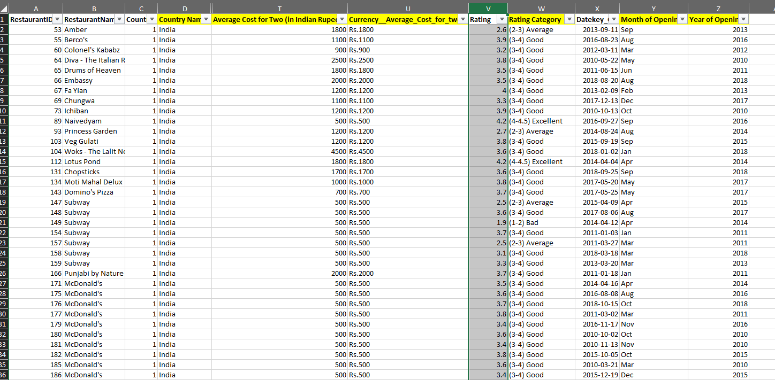
Methodology
The highlighted columns indicate the inclusion of new columns from the existing columns to make the data analysis and get more accurate insights from the dataset.

Slide 11
DATA ANALYSIS AND INSIGHTS

Slide 12
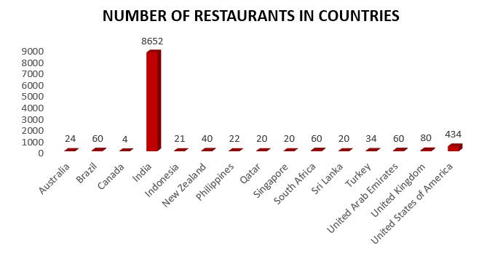
Number of Restaurants in each country
Number of Restaurants in each country
The chart in the left provides us number of restaurants in each countries.
This gives us a picture of how many restaurants are there in each countries,
This visual will be of much use to the management when looking for restaurant expansions in the future for the countries mentioned.

Slide 13
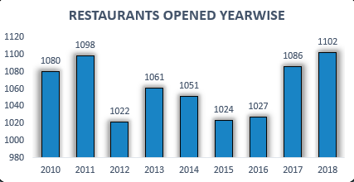
Restaurants Opened Year-wise
Year-wise Opening of Restaurants
The chart in the left provides us number of restaurants opened in the corresponding years.
We can gain insights from this as to how many restaurants have been opened year-wise.
It will also be helpful in the future to see if there is any pattern changes for restaurant count in the future.

Slide 14
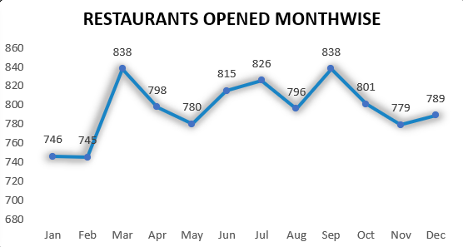
Restaurants Opened Month-wise
Month-wise Opening of Restaurants
The line chart in the left provides us number of restaurants opened according to the months of the year.
We can gain insights from this as to how many restaurants have been opened month wise.
It will also be helpful in the future to see if there is any pattern changes in the count of restaurants being opened monthwise in the future.

Slide 15
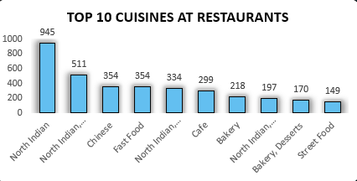
Top 10 Cuisines
Cuisines and Restaurant Count
The chart picturizes the top 10 cuisines of the restaurants across the world who have partnered with Zomato.
This provides an insight as to which cuisines are present in most of the restaurants.
When a restaurant is opened in the future, this chart will be helpful in choosing the cuisine for the restaurant to be opened.

Slide 16
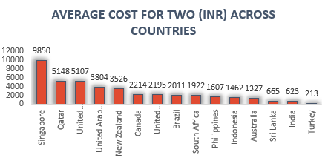
Average Cost per two (INR) across countries
Average Cost per two people across Countries
We can visualize the average cost per two people in Indian Rupees across the countries.
Singapore has the highest average cost with 9850 INR while Turkey has the least average cost with 213 INR
When a restaurant is opened in the future, this chart will help to decide the pricing of the restaurant.

Slide 17
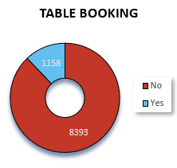
Table Booking Distribution
Table Booking distribution across Countries
We can visualize the distribution of table booking in various restaurants across the world.
We can see that almost 85% of the restaurants do not offer table booking whereas almost 15% of the restaurants offer table booking.
If a restaurant is opened in future, the table booking to be provided or not depends on factors like the location, average cost etc.

Slide 18
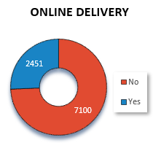
Online Delivery Distribution
Online Delivery distribution across Countries
We can visualize the distribution of online delivery in various restaurants across the world.
We can see that almost 75% of the restaurants don’t offer online delivery whereas almost 25% of the restaurants offer online delivery.
If a restaurant is opened in future, the table booking to be provided or not depends on factors like the location, average cost etc.

Slide 19
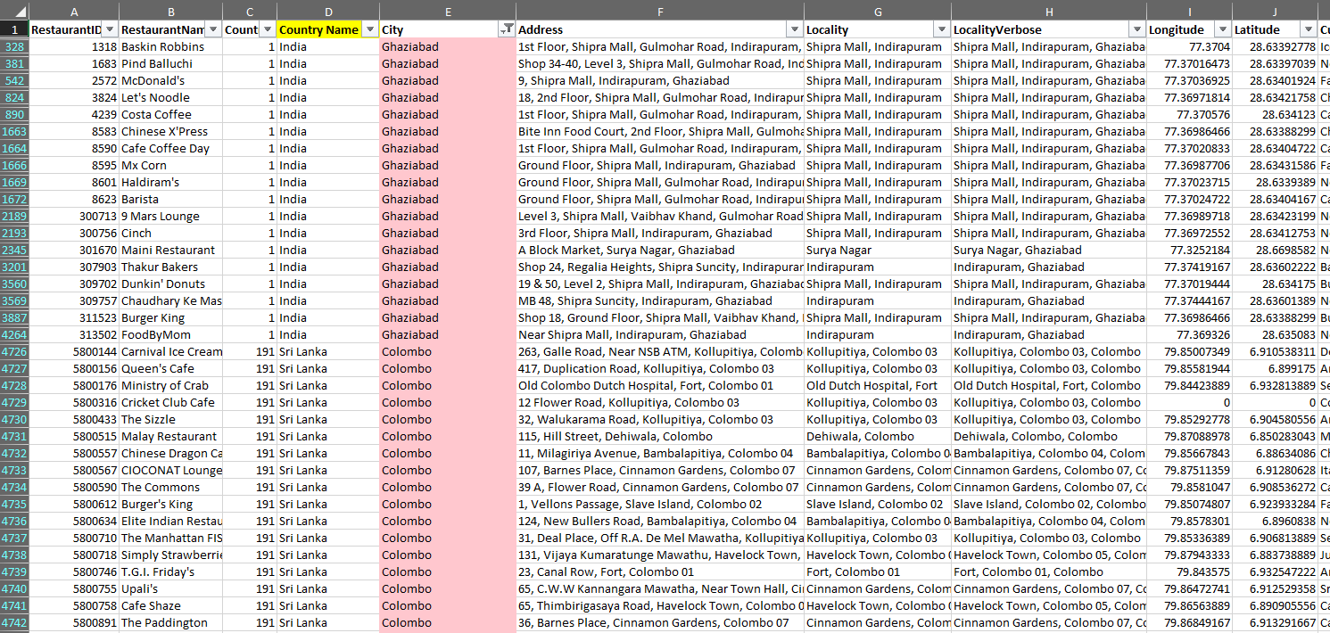
Suggested cities to open new restaurants
Highlighting the suggested cities where new restaurants can be opened
The suggested cities for opening new restaurants have been highlighted using the conditional formatting feature as follows:
Brasí_lia, Brazil
Ghaziabad, India
Singapore, Singapore
Colombo, Sri Lanka
Birmingham, United Kingdom
Gainesville, United States of America
The cities are suggested on the basis of factors like average cost, rating, votes, online delivery.

Slide 20
SUGGESTIONS AND RECOMMENDATIONS

Slide 21
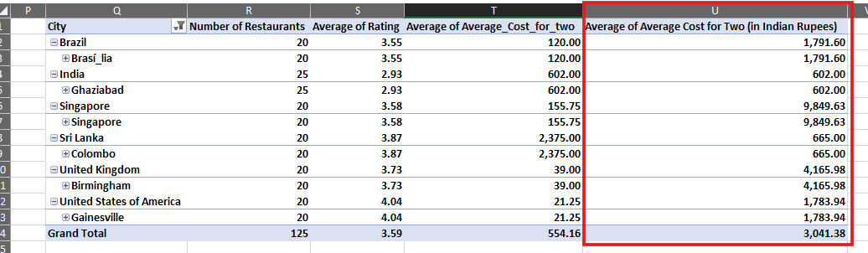
Suggestions for Opening New Restaurants
Opening new restaurants at a location depends on various factors like price range, customer ratings, average cost etc.
Based on the data, it would be a good idea / recommendation to open more restaurants in few cities and countries as follows:
Brasí_lia, Brazil
Ghaziabad, India
Singapore, Singapore
Colombo, Sri Lanka
Birmingham, United Kingdom
Gainesville, United States of America

Slide 22
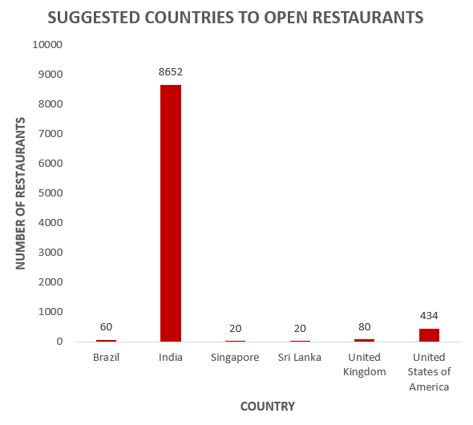
Recommendations for Opening New Restaurants
Recommended countries where new restaurants can be opened
We have made use of a column chart to show the number of restaurants in each country.
While opening restaurants in these cities, various factors such as average rating, average cost for two, cuisines should be considered.
Recommendation:
Recommended countries to open new restaurants are Brazil, Singapore, Sri Lanka, United Kingdom, United States of America and India with lesser competition where the average ratings are between 2 and 3 out of 5.
Also, the average cost per two people ranges from 600 INR (India) to 9850 (INR) in Singapore, which would be a good recommendation to open new restaurants as the ranges of prices in these countries is diverse.

Slide 23
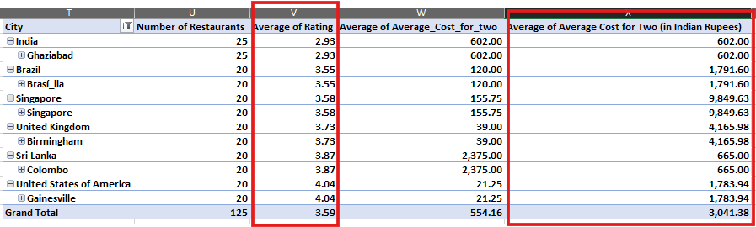
Suggestions for Opening New Restaurants based on cost and rating
Rating and Cost comparison of cities where new restaurants can be opened
Considering the ratings and the average cost factor new restaurants can be opened in places like Brasi_lia (Brazil), Ghaziabad (India), Colombo (Sri Lanka) where the number of restaurants in these cities range between 20 to 25.
The average customer ratings in these cities ranges between 2.9 and 4.1 with India having the least rating of 2.9 and USA having the highest rating of 4.1.

Slide 24
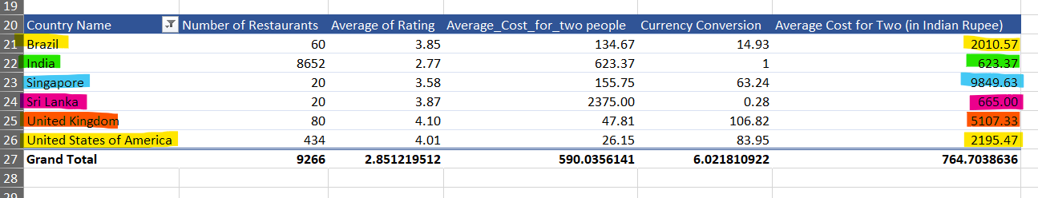
Suggestions for Opening New Restaurants
Rating and Cost comparison of countries where new restaurants can be opened
The reason for suggesting to open newer restaurants is that 95% of the restaurants are located across these 6 countries with prices ranging from 623 INR (India) to 9849 INR (Singapore)
In the upcoming slides, let us have a look at how the factors like rating, average cost per two, votes and cuisines play a major role in opening new restaurants across these countries.

Slide 25
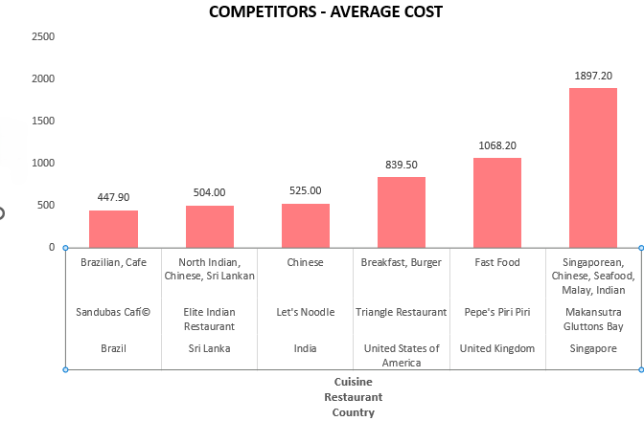
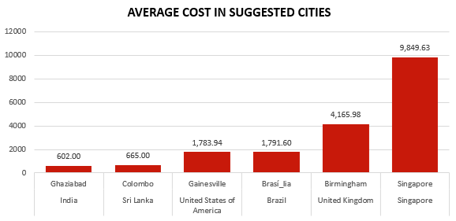
Competitor Analysis based on Average Cost
Competitors of restaurants to be opened in the suggested cities – Cost Comparison (Currency – INR)
VS
The left chart shows the average cost from the suggested restaurant while the chart on the right side depicts the average cost of the restaurants in the suggested city. (Currency Unit – INR)
For example, in Brasi_lia in Brazil,
Average cost of all restaurants – 1791.60 INR
Average cost in suggested restaurant – 447.90 INR
This means that we can open a restaurant in the suggested city as long as the average cost of the suggested restaurant is less than the average cost of all the restaurants in the suggested city.

Slide 26
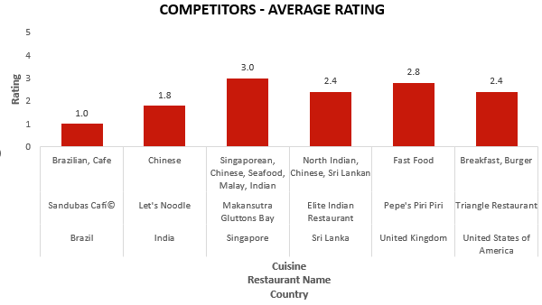
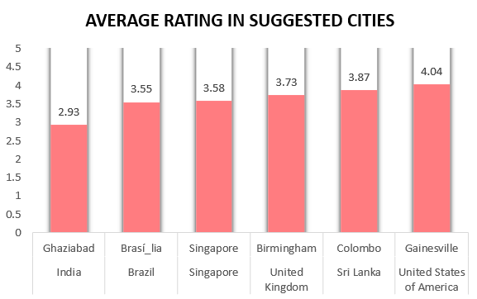
Competitor Analysis based on Average Rating
Competitors of restaurants to be opened in the suggested cities – Rating Comparison
VS
The left chart shows the average customer ratings from the suggested restaurant while the chart on the right side depicts the average customer ratings of the restaurants in the suggested city.
The suggested restaurants have a lower rating when compared to the average rating across the restaurants in the suggested city.
While opening a new restaurant in the suggested cities, these restaurants have a possibility of being a competitor in terms of pricing, locality, table bookings, online delivery, customer votes etc.

Slide 27
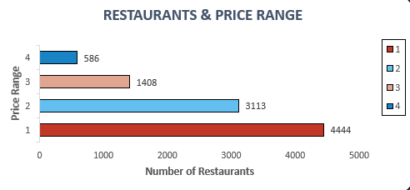
Suggestions – Price Range for the upcoming Restaurants
Price Range and Number of Restaurants
The distribution of restaurants with price range from 1 to 4 is as follows:
Price Range 1 – 4444 (46.53%)
Price Range 2 – 3113 (32.60%)
Price Range 3 – 1408 (14.74%)
Price Range 4 – 586 ( 6.13%)
We can observe that most of the restaurants fall in the price range 1 which means that there are high chances of a restaurant being opened in the future under the price range 1.

Slide 28
STRATEGIC RECOMMENDATIONS

Slide 29
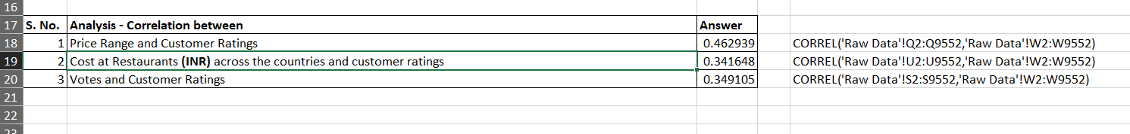
Recommendations based on factors
Dependency between price range, average cost, votes, customer ratings
Correlation is used to find if there is dependency between 2 numerical values. Higher the correlation, higher the dependency between those 2 numerical values.
In the example above, we can see that Price range and customer ratings has a correlation value of 46% which means that with respect to the price range, the customer ratings are affected accordingly.
This gives us an idea to open new restaurants considering the parameters like price range, customer ratings, average cost and total votes.
For analysis, we have converted all the currencies to a single common currency. In this case, analysis has been done by converting all the currencies to Indian Rupees (Rs.).

Slide 30
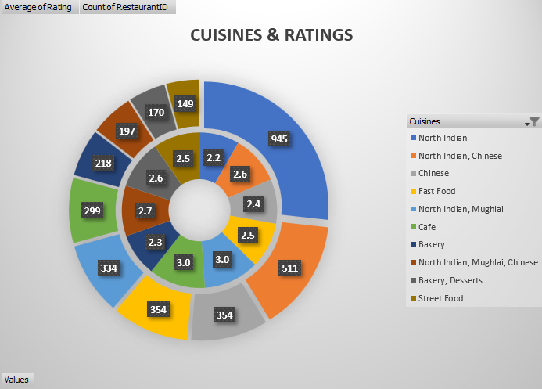
Recommended Cuisines
Cuisines and Rating
The cuisines definitely have an impact on the customer ratings.
Consider North Indian cuisine which is available in 945 restaurants has a average rating of 2.2, whereas restaurants with Street food cuisine is available at 149 restaurants with an average rating of 2.5.
From this visual, we can conclude that the customer ratings has a major effect on the choice of cuisines.

Slide 31
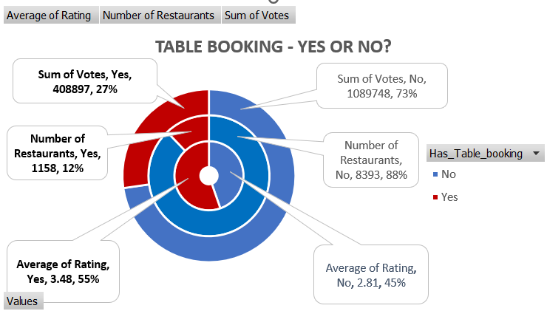
Recommendations for Table Booking
Table Booking comparison with Ratings and Votes
From the above chart, we can see that restaurant offering table booking is less than the ones that does not offer table booking.
While opening a new restaurant in any of the suggested cities, table bookings can increase or decrease depending on the location / locality.

Slide 32
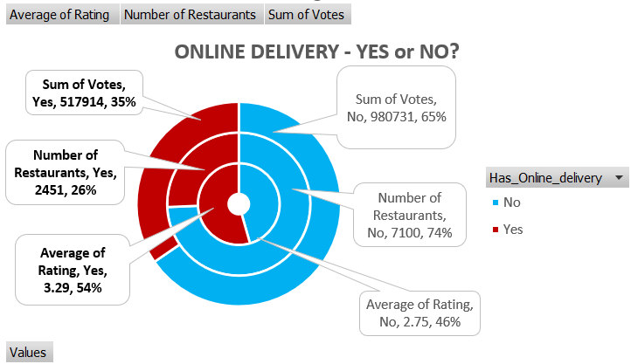
Recommendations for Online Delivery
Online Delivery comparison with Ratings and Votes
Around 25-28% of the restaurants offer online deliveries and the average ratings are higher than the restaurants that do not offer online delivery.
On analysis for the suggested cities, online delivery can be done for countries like India where many restaurants offer the same.

Slide 33
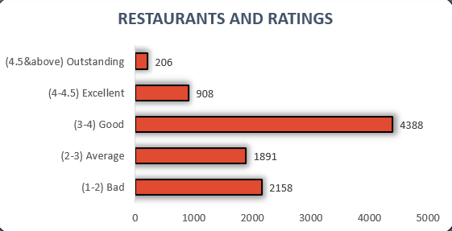
Recommendations for Improving Customer Rating
Restaurant and Ratings Comparison
The number of restaurants have been categorised in terms of ratings as follows:
The restaurants have been categorised as Bad, Average, Good, Excellent and Outstanding on the basis of customer ratings.
With this, we can analyse the restaurant ratings and provide insights to improve the ratings in the future.
Category | Rating | Number of Restaurants
Bad | 1-2 | 2158
Average | 2-3 | 1891
Good | 3-4 | 4388
Excellent | 4-4.5 | 908
Outstanding | >4.5 | 206

Slide 34
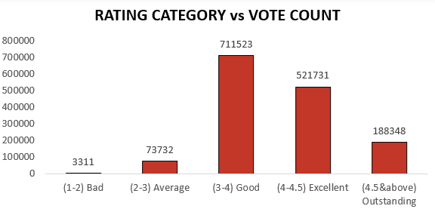
Recommendations for Improving Votes and Ratings
Ratings and Votes Comparison
The number of restaurants have been categorised with respect to the total voters.
This gives an idea of how many people have voted across the categories.
We can observe that most of the customers have voted for Good rating category (ratings between 3 and 4).
The count of votes significantly plays a major role in the ratings and this factor should be considered while opening a new restaurant in the future.

Slide 35
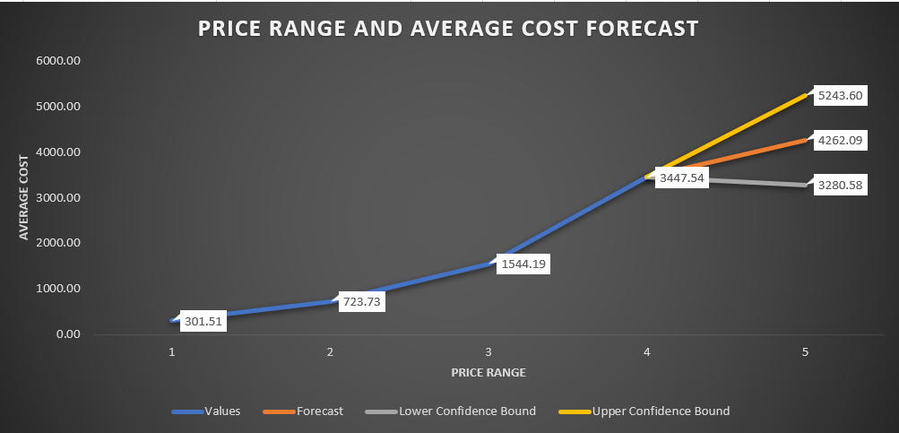
Recommendations for Forecasting Price Range
The price range in which a restaurant is placed in determines its average cost.
Forecasting for price range 5, the value would range between 3280 and 5243 with 4262 being the accurate forecasted value.
If a restaurant is opened in future and does not fall within the price range of 1 to 4, the forecasted value can be considered as the starting value for the price range 5.

Slide 36
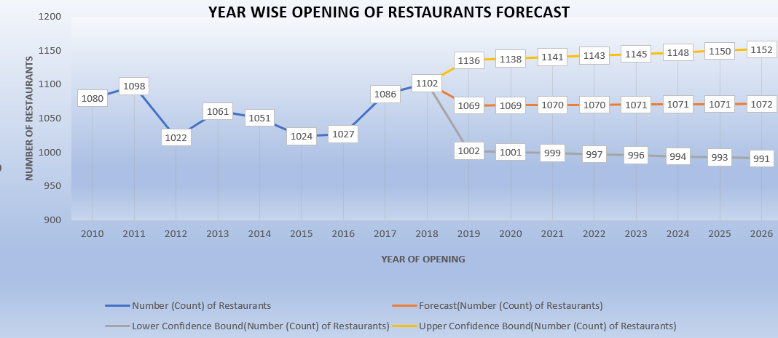
Recommendations for Forecasting number of restaurants Year-wise
The data consists of restaurants opened until 2018.
By using the data, we can forecast as to how many restaurants can possibly be opened in the upcoming years.
For example, the maximum number of restaurants opened in the next years may range between 991 & 1152.

Slide 37
DASHBOARD AND VISUALIZATIONS

Slide 38
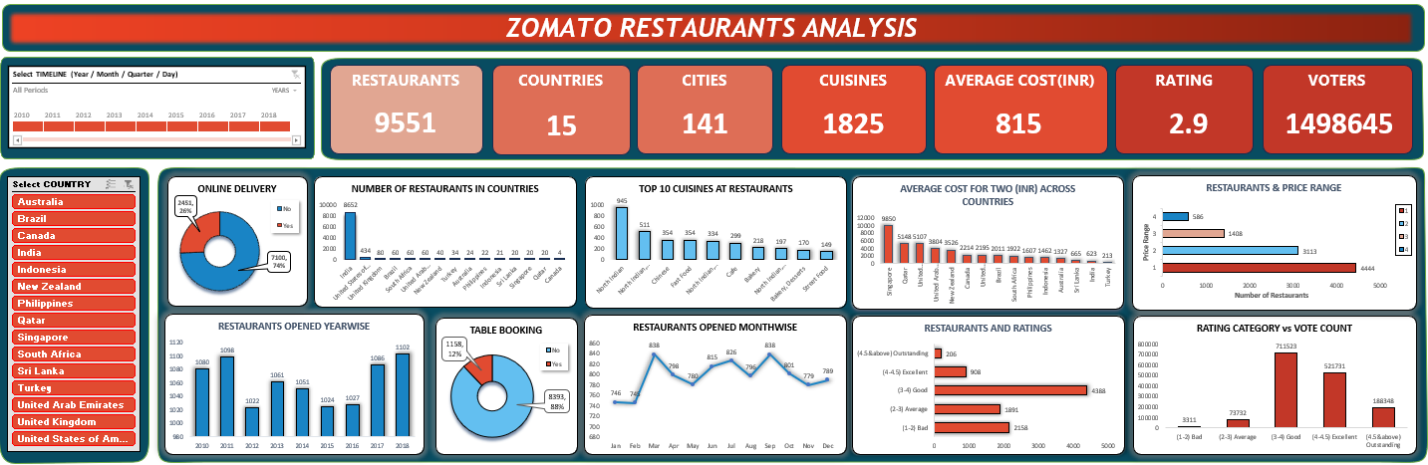
Dashboard and Visualizations

Slide 39
Dashboard and Visualizations
The dashboard in the previous slide consists of the following:
Timeline : Using the Datekey_Opening to display the data in terms of Days, Months, Quarters and Days
Slicers: Values in the Country Name Column to filter the data according to the country Name.
Charts –
Pie Charts: Used to view the distribution of restaurants across various parameters like Table Booking, Online Delivery, Price Range
Column Charts : To view the count of restaurants according to countries, the rating category, number of voters and the restaurants opened month wise etc.
The visuals are dynamic and change with respect to the selected countries. Multiple countries can be selected. The same applies to the date range timeline too.
The dashboard in the next slide displays all the visuals with respect to a particular country. For example, the country considered for the visualization is India.

Slide 40
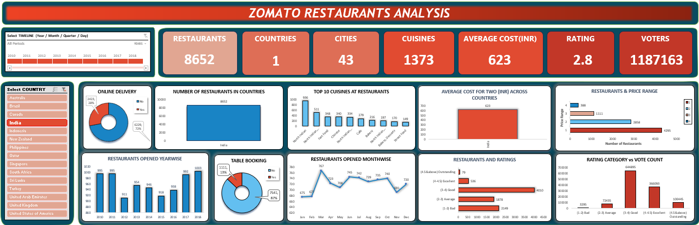
Dashboard and Visualizations

Slide 41
Dashboard and Visualizations
The parameters in the above visuals are termed as KPIs (Key Performance Indicators), representing the values of each parameters.
At a glance, we can get insights from the dashboard like the number of restaurants, number of countries, average customer rating, number of cuisines, total votes etc.
These visuals are user friendly and easier to understand.

Slide 42
CONCLUSION

Slide 43
Conclusion
The presentation covers the strategic insights by analysing various aspects such as price range, customer ratings, average cost per two persons, votes etc.
The objective and subjective questions raised from the tasks has been addressed by using dashboards with multiple visuals such as line charts, column charts, slicers and timelines.
The country slicer and date timeline will help us to visualize the required data in terms of the countries, days, months, quarters and years.
Forecasting has been done to see how many restaurants will be opened year-wise in the future
Other concerns such as cuisines being affected by ratings, ratings in accordance with the total votes have also been addressed in the attached spreadsheet file.

Slide 44
ACKNOWLEDGEMENT AND REFERENCES

Slide 45
Acknowledgements and References
References -
Newton School Spreadsheet Lectures – https://drive.google.com/drive/folders/1eqVJdcRQzdVH4fYFBf34azka-Z7biymy
https://answers.microsoft.com/en-us/msoffice/forum/all/looking-to-extract-text-from-within-a-parentheses/304a76b6-2325-48f1-909f-760ffa08b045
Count Distinct Values from text column to display KPIs (Restaurants, Cities, Cuisines etc.) https://www.youtube.com/watch?v=NV3w5SiX09c
Data Visualization Color Palettes for telling better story with your data https://www.heavy.ai/blog/12-color-palettes-for-telling-better-stories-with-your-data

